Slide 1

Shiny App Workshop (II)
ISSS616 Applied Statistical Analysis with R (ASAR)
February 2023
SMU School of Computing and Information Systems
Masters of IT in Business AY 2022-2023 – Term 2

Slide 2

1. ggplot

Slide 3
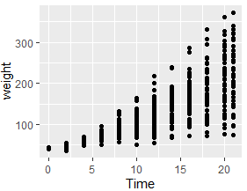
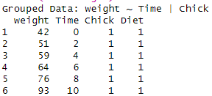
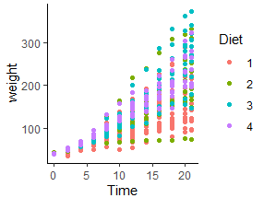
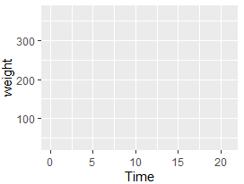
ggplot
The grammar of graphics
Structure:
Tidy data
Mapping "aesthetics" to the plot
Geoms -geometric shapes on the plot e.g. point, bar or line
Facets – split data into subsets to create multiple variations of the same graph
Coordinate system
Labels, legends and other annotations
ggplot(ChickWeight, aes(x = Time, y = weight)) +
geom_point()
geom_point() adds points that represents the difference pairs of weight and time value
Joined with ggplot by "+"
library(tidyverse)
head(ChickWeight)
ggplot(ChickWeight, aes(x = Time, y = weight)) +
geom_point(aes(color = Diet)) +
coord_cartesian() +
theme_classic()
Map color of the points to diet type Coordinate system and theme are also added
ggplot(ChickWeight, aes(x = Time, y = weight))
Time mapped to x axis
Weight mapped to y axis

Slide 4
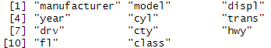
Scatter plot
present the relationship between two continuous variables in a data set
#understand the dataset
?mpg
#names of all variables
names(mpg)
Fuel economy data from 1999 to 2008 for 38 popular models of cars:
displ: engine displacement in litres
hwy: highway miles per gallon
Drv: type of drive train, where f = front-wheel drive, r = rear wheel drive, 4 = 4wd

Slide 5
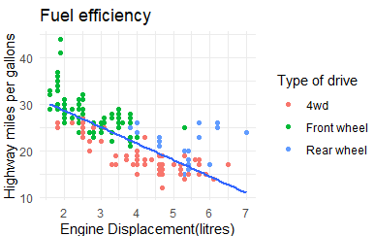
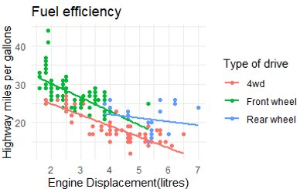
Scatter plot
If colour label is defined in geom_point() layer, it is not associated with the subsequent layer in geom_smooth()
ggplot(mpg, aes(x=displ, y=hwy)) +
geom_point(aes(colour=drv))+
geom_smooth(method=lm, se=F)+
labs(x="Engine Displacement(litres)",
y="Highway miles per gallons",
colour="Type of drive",
title="Fuel efficiency")+
scale_color_hue(labels=c("f"='Front wheel', "r"='Rear wheel', "4"="4wd"))+
theme_minimal()
ggplot(mpg, aes(x=displ, y=hwy, colour=drv)) +
geom_point()+
geom_smooth(method=lm, se=F)+
labs(x="Engine Displacement(litres)",
y="Highway miles per gallons",
colour="Type of drive",
title="Fuel efficiency")+
scale_color_hue(labels=c("f"='Front wheel', "r"='Rear wheel', "4"="4wd"))+
theme_minimal()

Slide 6
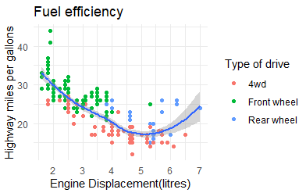
Scatter plot
geom_smooth() plot a smooth line with standard error/confidence band displayed
ggplot(mpg, aes(x=displ, y=hwy)) +
geom_point(aes(colour=drv))+
geom_smooth(method=lm, se=F)+
labs(x="Engine Displacement(litres)",
y="Highway miles per gallons",
colour="Type of drive",
title="Fuel efficiency")+
scale_color_hue(labels=c("f"='Front wheel', "r"='Rear wheel', "4"="4wd"))+
theme_minimal()
ggplot(mpg, aes(x=displ, y=hwy)) +
geom_point(aes(colour=drv))+
geom_smooth()+
labs(x="Engine Displacement(litres)",
y="Highway miles per gallons",
colour="Type of drive",
title="Fuel efficiency")+
scale_color_hue(labels=c("f"='Front wheel', "r"='Rear wheel', "4"="4wd"))+
theme_minimal()

Slide 7
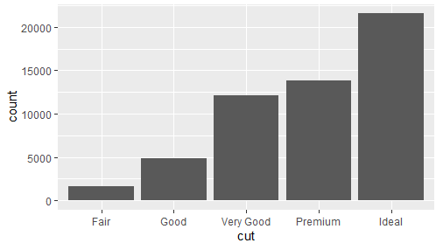
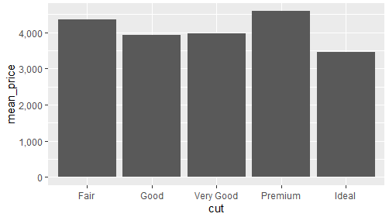
Bar chart
#Use the pipe operator to plot wrangled data
diamonds %>%
group_by(cut) %>%
summarise(mean_price=mean(price)) %>%
ggplot(aes(x = cut, y = mean_price)) +
geom_col()
Presents categorical data with rectangular bars with heights or lengths proportional to the values that they represent
Two types of bar charts: geom_bar() and geom_col()
geom_bar() uses stat_count() by default: counts the number of cases at each x position
geom_col() uses stat_identity: leaves data as it is
#Need to add stat="identity" to geom_bar()
diamonds %>%
group_by(cut) %>%
summarise(mean_price=mean(price)) %>%
ggplot(aes(x = cut, y = mean_price)) +
geom_bar(stat="identity")
#Frequency plot for each cut type
ggplot(diamonds, aes(x = cut)) +
geom_bar()

Slide 8
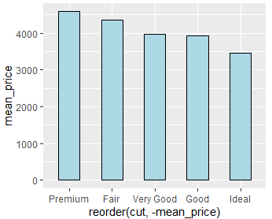
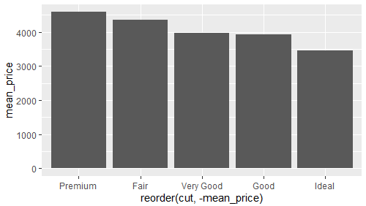
Bar chart - reorder
Reorder() function to change the order of the graphs:
ggplot(dataframe name, aes(x=reorder(column1,±column2),y=column2)
"+" : ascending order
"-" : descending order
#adjust column width and colors
diamonds %>%
group_by(cut) %>%
summarise(mean_price=mean(price)) %>%
ggplot(aes(x = reorder(cut, -mean_price), y = mean_price)) +
geom_col(width=0.5, fill="lightblue", colour="black")
diamonds %>%
group_by(cut) %>%
summarise(mean_price=mean(price)) %>%
ggplot(aes(x = reorder(cut, -mean_price), y = mean_price)) +
geom_col()

Slide 9
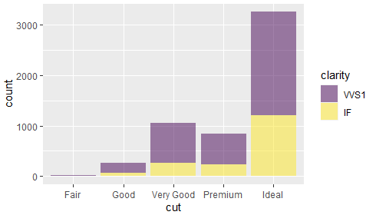
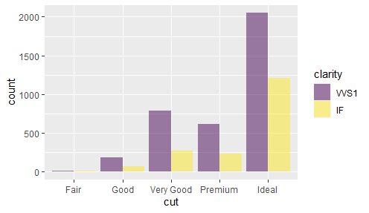
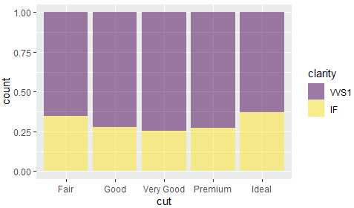
Bar chart – group bars
#group bars together by a second variable
#side by side
diamonds %>%
filter(clarity=="VVS1"| clarity=="IF") %>%
ggplot(aes(x = cut,fill=clarity)) +
geom_bar(position="dodge", alpha=0.5)
#stacked bar graph
diamonds %>%
filter(clarity=="VVS1"| clarity=="IF") %>%
ggplot(aes(x = cut,fill=clarity)) +
geom_bar(alpha=0.5)
#stacked bar graph with position="fill"
#y axis shows proportions
diamonds %>%
filter(clarity=="VVS1"| clarity=="IF") %>%
ggplot(aes(x = cut,fill=clarity)) +
geom_bar(position="fill", alpha=0.5)

Slide 10
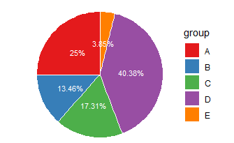
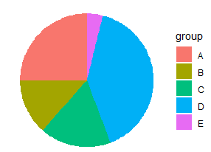
Pie chart
#To label the different pie, need to compute the y position of labels
# Compute the position of labels
data <- data %>%
arrange(desc(group)) %>%
mutate(prop = round(value/sum(data$value)*100, 2)) %>%
mutate(ypos = round(cumsum(prop)- 0.5*prop,2))
ggplot(data, aes(x="", y=prop, fill=group)) +
geom_bar(stat="identity", width=1, color="white") +
coord_polar("y", start=0) +
theme_void() +
geom_text(aes(y = ypos, label = paste0(prop,"%")), color = "white", size=3) +
scale_fill_brewer(palette="Set1")
A circular statistical graphic, which is divided into slices to illustrate numerical proportion
Use geom_bar() and make it circular with coord_polar()
#create data
data <- data.frame(
group=LETTERS[1:5],
value=c(13,7,9,21,2)
)
#basic piechart
ggplot(data, aes(x="", y=value, fill=group)) +
geom_bar(stat="identity", width=1) +
coord_polar("y", start=0)+
theme_void()

Slide 11
Theme
theme_bw(): a variation on theme_grey() that uses a white background and thin grey grid lines.
theme_linedraw(): a theme with only black lines of various widths on white backgrounds, reminiscent of a line drawing.
theme_light(): similar to theme_linedraw() but with light grey lines and axes, to direct more attention towards the data.
theme_dark(): the dark cousin of theme_light(), with similar line sizes but a dark background. Useful to make thin coloured lines pop out.
theme_minimal(): a minimalistic theme with no background annotations.
theme_classic(): a classic-looking theme, with x and y axis lines and no gridlines.
theme_void(): a completely empty theme.
Reference:
https://ggplot2-book.org/polishing.html

Slide 12
2. Map

Slide 13
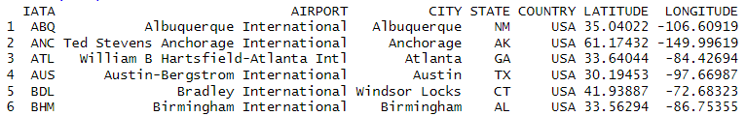
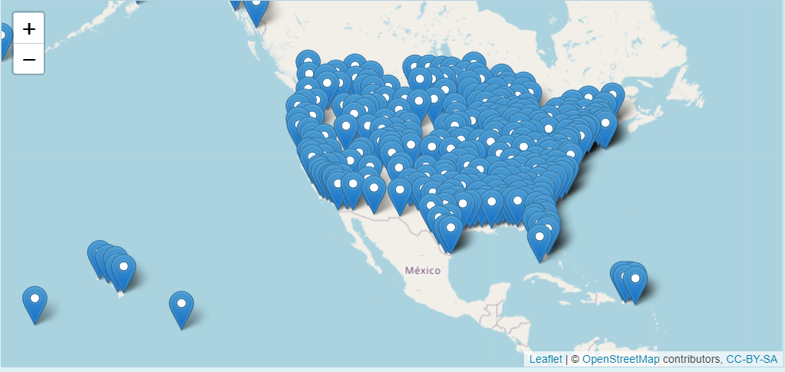
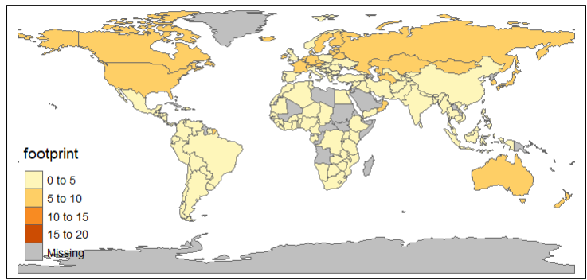
Map
leaflet
Creating Maps with R
Plot by area
tmap
Plot by Lat/Long
leaflet
#call library and import data
install.packages("leaflet")
library(leaflet)
data <- read.csv("airports.csv")
head(data)
tmap
open-source R-library for drawing thematic maps.
The API is based on A Layered Grammar of Graphics and resembles the syntax of ggplot2
leafMap <- leaflet(data = data) %>%
setView(lat = 36.5588659,
lng = -107.6660877,
zoom = 3) %>%
addTiles() %>%
addMarkers(~LONGITUDE, ~LATITUDE,
popup = ~AIRPORT, label = ~AIRPORT)
leafMap
#call library and import data
install.packages("tmap")
library(tmap)
data("World")
tmap_mode("view")
tm_shape(World) +
tm_polygons("footprint")

Slide 14
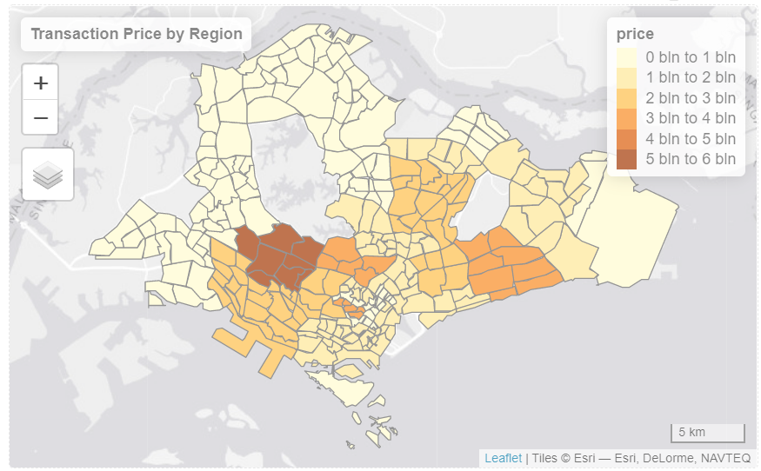
Working on tmap with shape file
#call library and import data
install.packages("tmap")
library(tmap)
library(sf)
realis2018 <- read_csv("data/realis2018.csv")head(realis2018,5)
#import shape file
shapefile <- st_read("shapefile/MP14_SUBZONE_NO_SEA_PL.shp")
#group transaction by region
df <- realis2018 %>%
group_by(`Planning Area`) %>%
summarise(price=sum(`Transacted Price ($)`))
# Combine shape file with csv data
data_map_area <- inner_join(shapefile, df, by= c("PLN_AREA_N" = "Planning Area"))
# color the polygon with data
tmap_options(check.and.fix = TRUE)
tmap_mode("view")
qtm(data_map_area, fill="price", fill.id = "PLN_AREA_N", title = "Transaction Price by Region")

Slide 15
3. Hands-on

Slide 16
Overall steps
Explore data
Design visualization
Design app lay-out
Create interactive RShiny app

Slide 17
1. Explore data -Loading of data
#Load all libraries to be used
library(shiny)
library(shinydashboard)
library(tidyverse)
library(readxl)
library(leaflet)
library(leaflet.extras)
#Method 1: copy the whole file path​
#Remember to switch \ to /​
​
ec_data<-read.csv("C:/Users/User/Desktop/MITB Program/TA for ASAR/Workshop 2 handson/ec_data_workshop.csv")
#Method 2: save the file in the same directory as R project
ec_geo2 <- read_xlsx("ec_geo2.xlsx")
ec_data <- read_csv('ec_data_workshop.csv')
read_csv(): comma separated (CSV) files
read_excel(): xls and xlsx files
read_tsv(): tab separated files
read_delim(): general delimited files

Slide 18
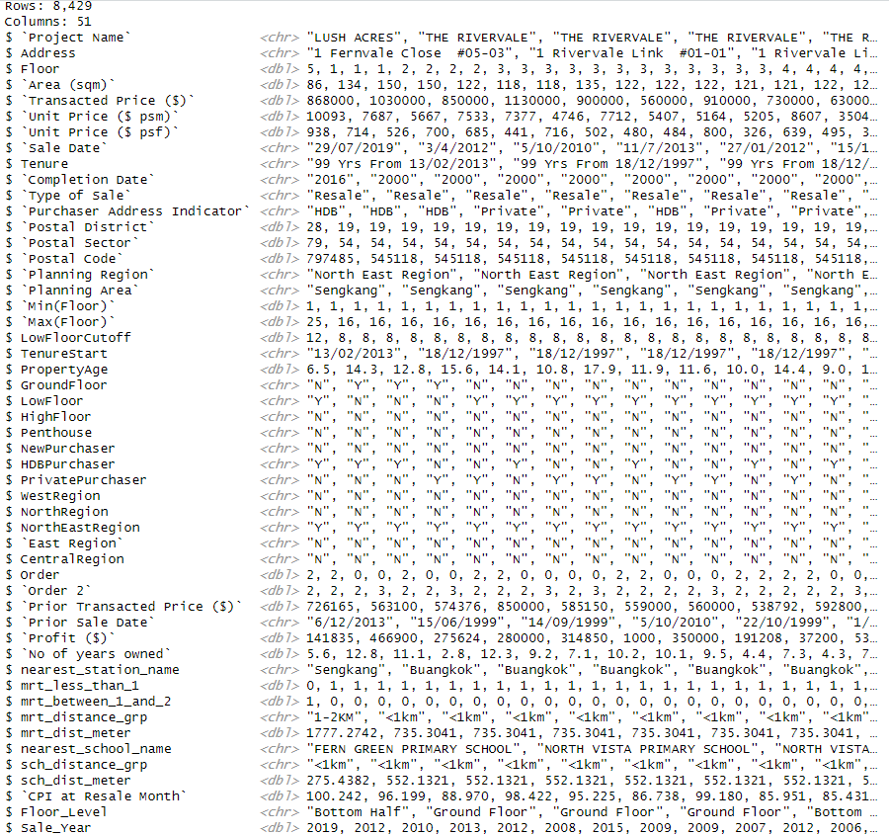
1. Explore data - Data analysis
51 variables
8,429 observations
#Check all variables
glimpse(ec_data)

Slide 19
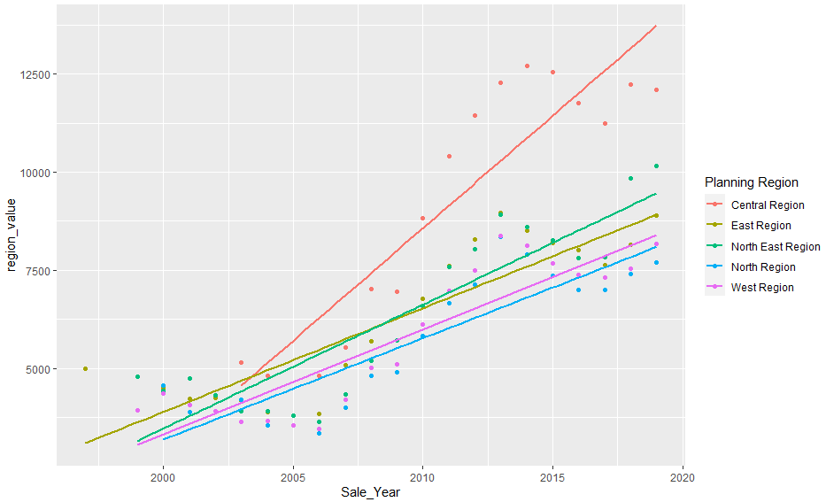
2. Data visualization – scatter plot
#Analyse sale trend by planning region and sale year
ec_data %>%
group_by(`Planning Region`,Sale_Year) %>%
summarise(region_value = mean(`Unit Price ($ psm)`, na.rm = T)) %>%
ggplot(aes(x=Sale_Year, y=region_value, colour=`Planning Region`))+
geom_point()+
geom_smooth(method=lm, se=F)
Remove NA values to calculate mean price

Slide 20
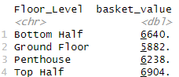
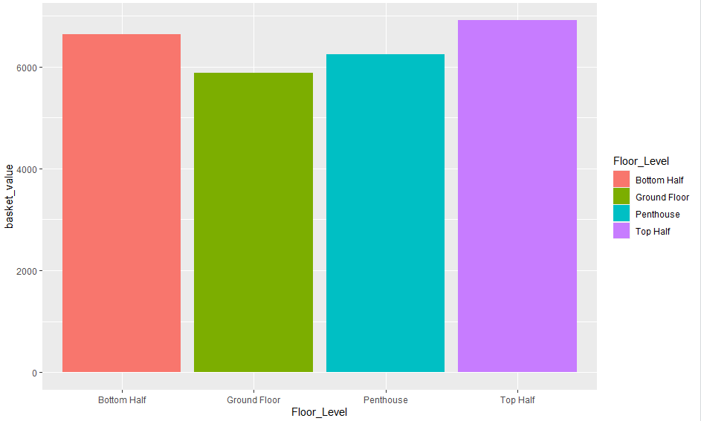
2. Data visualization – bar chart
#Analyse average sales price by floor level
ec_data %>%
group_by(Floor_Level) %>%
filter(`Completion Date` != 'Uncompleted', `Completion Date` != 'Unknown') %>%
summarise(basket_value = mean(`Unit Price ($ psm)`, na.rm = T)) %>%
ggplot(aes(x=Floor_Level, y=basket_value))+
geom_col(aes_string(fill='Floor_Level'))
Try it yourself:
Plot bar chart for the mean unit price per square meter by:
Distance from MRT
Completion Date

Slide 21
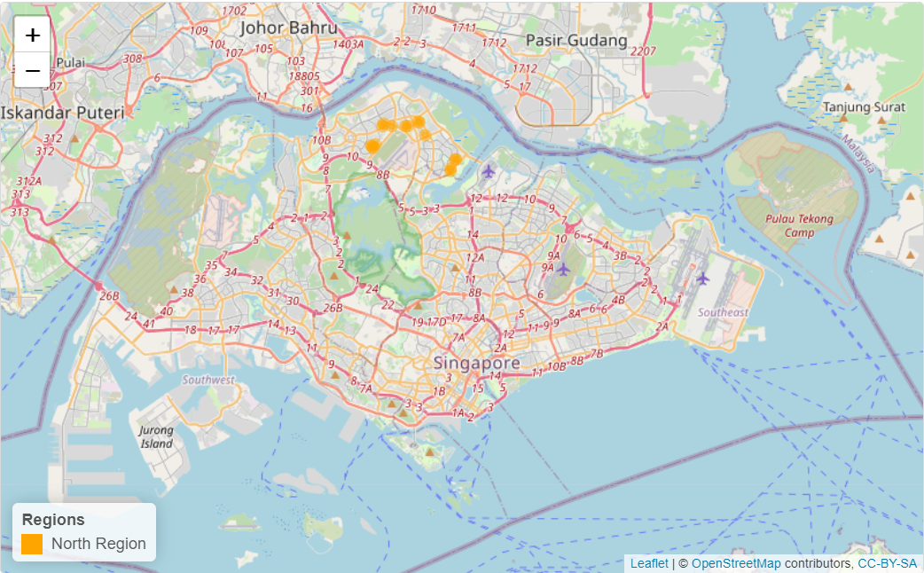
2. Data visualization - map
ec_geo2 <- read_xlsx("data/ec_geo2.xlsx")
pal <- colorFactor(palette = c("red", "green",
"blue", "orange", "purple"),
levels = c("East Region",
"North East Region",
"West Region", "North Region",
"Central Region"))
display_map <- ec_geo2 %>%
filter(`Planning Region` == "North Region") %>%
leaflet() %>%
setView(lng = 103.8522, lat = 1.347510, zoom = 11) %>%
addTiles() %>%
addCircleMarkers(label = ~ pjname,
color = ~ pal(`Planning Region`),
radius = 3, fillOpacity = 0.5) %>%
addLegend("bottomleft", pal = pal,
values = ~`Planning Region`,
opacity = 1, #color transparency
title = "Regions")
display_map

Slide 22
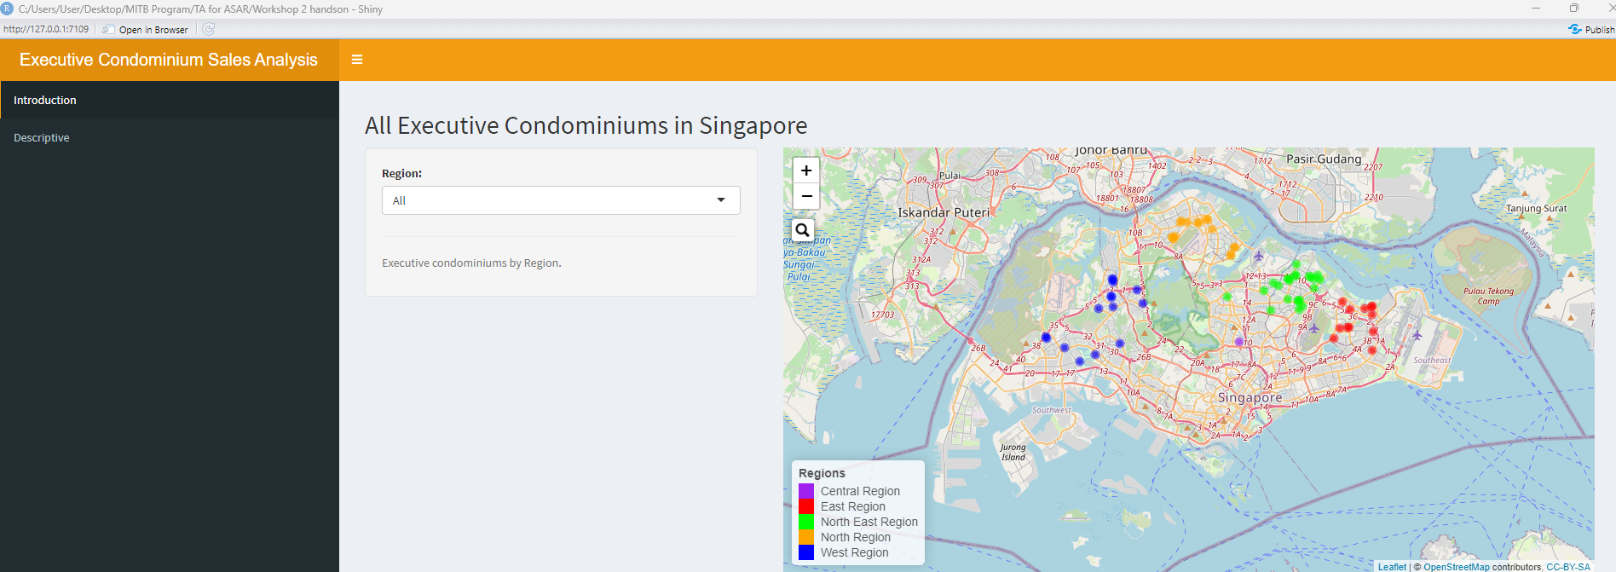
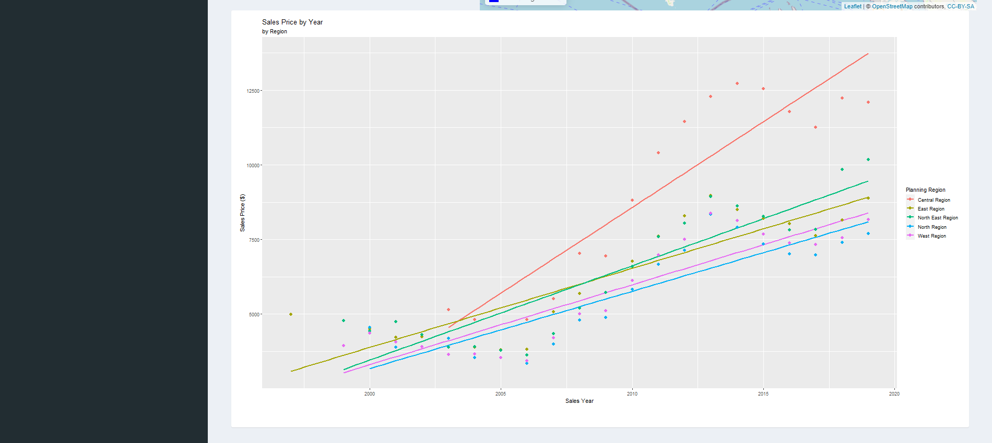
3. Design app lay-out
Structure:
DashboardHeader with title 'Executive Condominium Sales Analysis'
Two menuItems under sidebarMenu: Introduction and Descriptive
DashboardBody: two tabItems to match with two menuItems

Slide 23
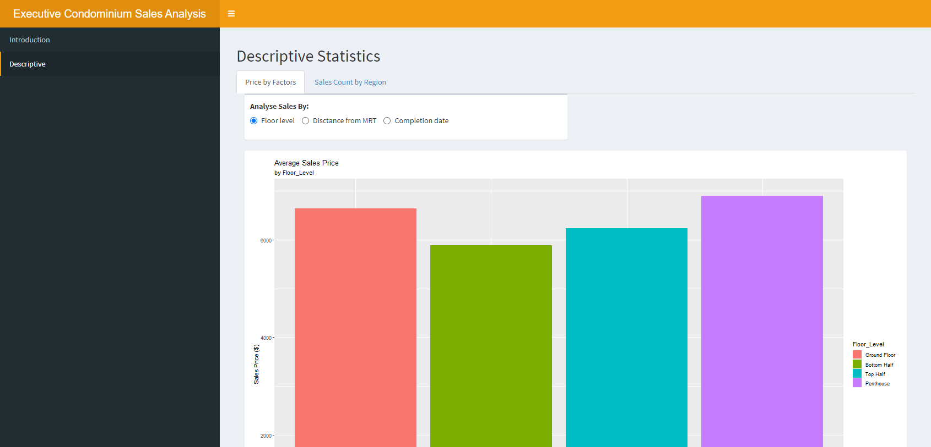
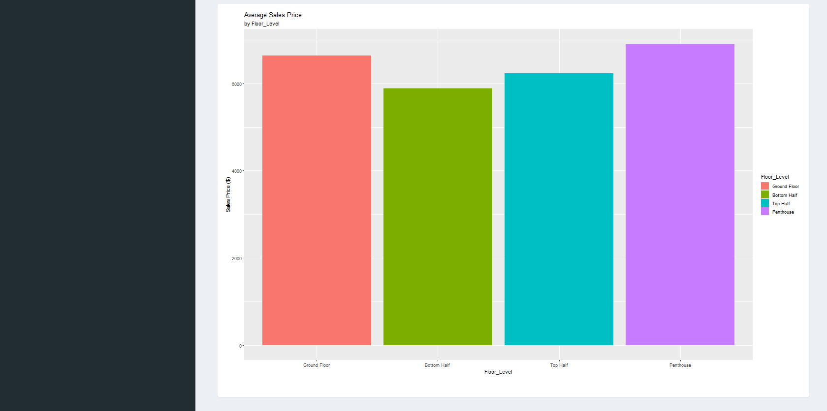
3. Design app lay-out
Structure:
DashboardHeader with title 'Executive Condominium Sales Analysis'
Two menuItems under sidebarMenu: Introduction and Descriptive
DashboardBody: two tabItems to match with two menuItems

Slide 24
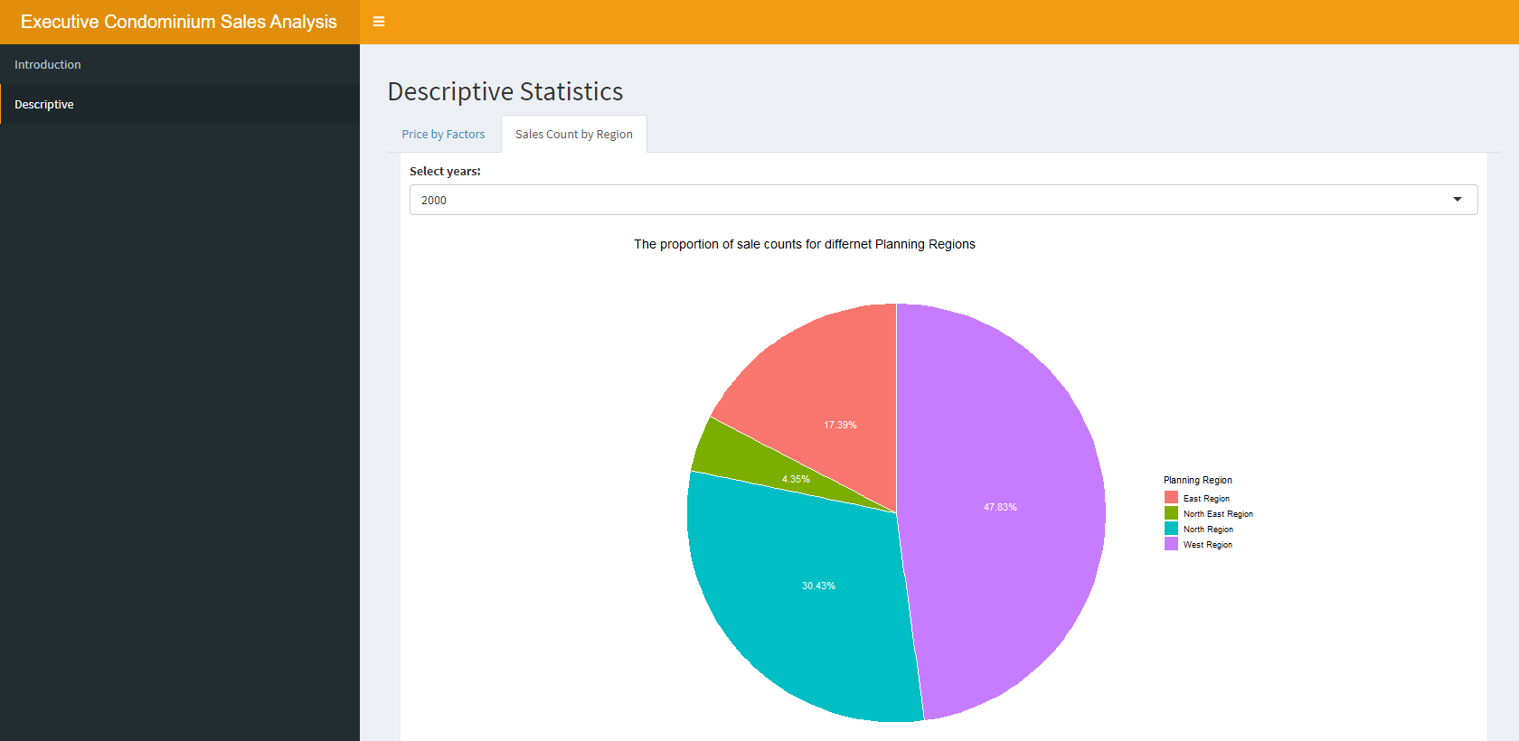
3. Design app lay-out
Structure:
DashboardHeader with title 'Executive Condominium Sales Analysis'
Two menuItems under sidebarMenu: Introduction and Descriptive
DashboardBody: two tabItems to match with two menuItems

Slide 25
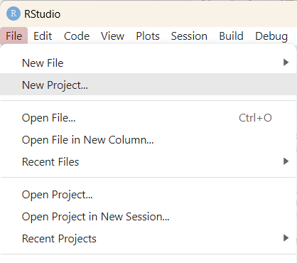
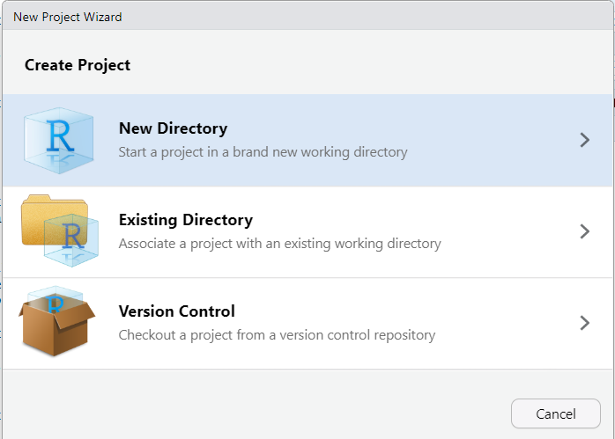
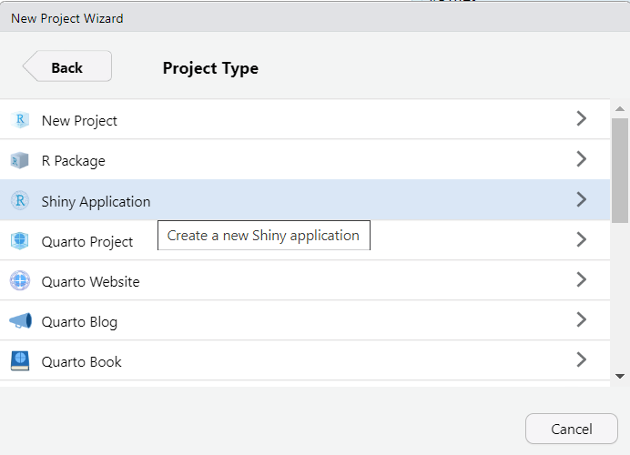
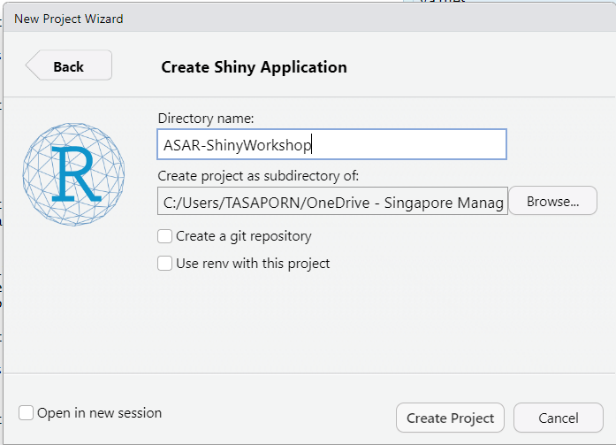
4. Create interactive RShiny app

Slide 26
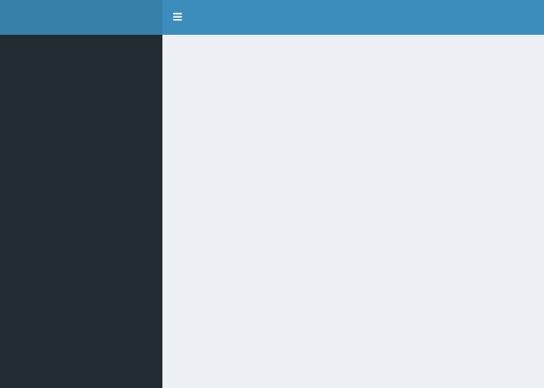
Shinydashboard
A package provides a theme on top of 'Shiny', making it easy to create attractive dashboards.
Default dashboardPage(skin="blue")
Other color themes(skins) includes black, purple, green, red and yellow:
https://rstudio.github.io/shinydashboard/appearance.html
An example:
https://gallery.shinyapps.io/087-crandash/
# The dashboardPage() function expects three components: a header, sidebar, and body:
ui<-dashboardPage( dashboardHeader(), dashboardSidebar(), dashboardBody() )
server <-function(input,output){}
shinyApp(ui,server)
#For more complicated apps, splitting app into pieces can make it more readable:
header <- dashboardHeader() sidebar <- dashboardSidebar() body <- dashboardBody() dashboardPage(header, sidebar, body)

Slide 27
Shinydashboard
# To install if in Rscript
install.packages("shinydashboard")
#Basic structure
library(shiny)
library(shinydashboard)
ui <- dashboardPage(skin = 'yellow',
dashboardHeader(title = 'Executive Condominium Sales Analysis', titleWidth = 400),
dashboardSidebar(sidebarMenu(menuItem('Introduction', tabName = 'Introduction'),
menuItem('Descriptive',tabName = 'Descriptive')
)
),
dashboardBody(
tabItems(
tabItem(tabName = 'Introduction',
fluidPage(
titlePanel("All Executive Condominiums in Singapore")
)
),
tabItem(tabName = 'Descriptive',
fluidPage(
titlePanel("Descriptive Statistics"),
tabsetPanel(
tabPanel("Price by Factors"),
tabPanel("Sales Count by Region")
)
)
))))
server <- function(input, output) { }
shinyApp(ui, server)
The menu items are put in sidebarMenu() as follows. To match up a menuItem with a tabItem, make sure that they have matching values for tabName.

Slide 28
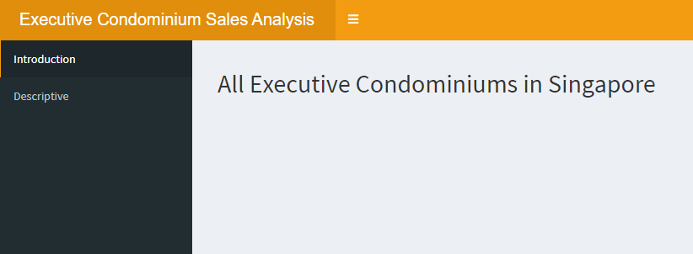
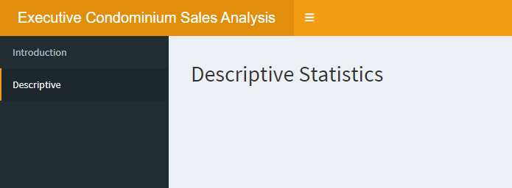

Slide 29
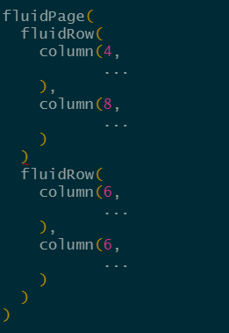
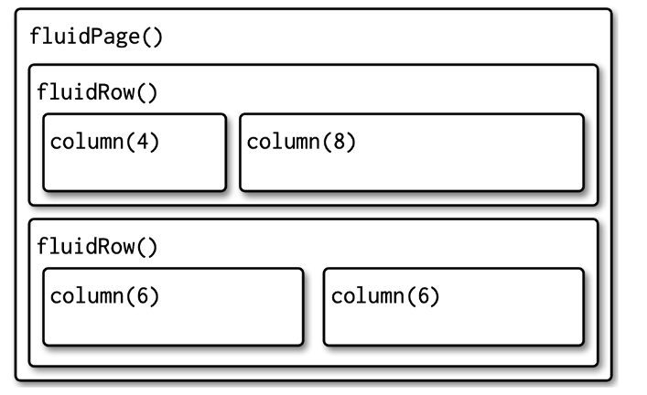
Layout with Shiny grid layout system
Layout functions provide the high-level visual structure of an app. Layouts are created by a hierarchy of function calls, where the hierarchy in R matches the hierarchy in the generated HTML.
In general, you start with fluidPage() as a big frame. The you use fluidRow() to create sections inside. And inside the fluidRow(), you can add columns with column().
Notes:
We’ll start by talking about page layouts (both single and “multiple”) that let you organise your inputs and outputs.
Then you’ll learn how to customise its overall visual appearance with themes.
We’ll finish with a brief discussion of what’s going on under the hood so that if you know HTML and CSS you can customise Shiny apps still further.

Slide 30
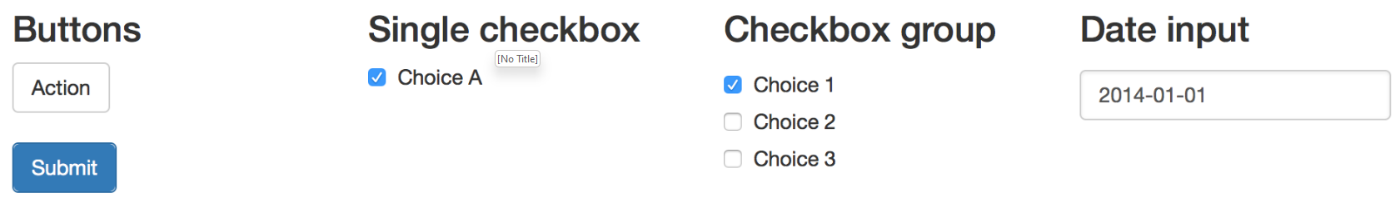
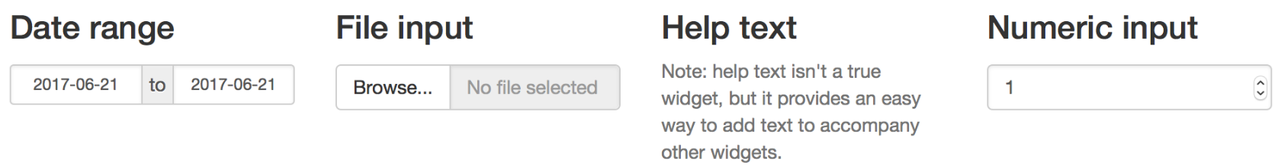
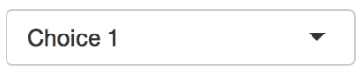

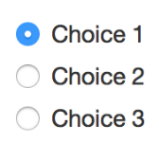
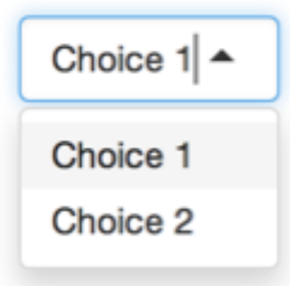
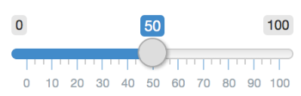
Inputs widgets
Link for widget
Cheat sheet
actionButton(inputId, label, icon, width, …) | checkboxInput(inputId, label, value, width) | dateInput(inputId, label, value, min, max, format, startview, weekstart, language, width, autoclose, datesdisabled, daysofweekdisabled) | dateRangeInput(inputId, label, start, end, min, max, format, startview, weekstart, language, separator, width, autoclose)
fileInput(inputId, label, multiple, accept, width, buttonLabel, placeholder) | numericInput(inputId, label, value, min, max, step, width) | selectInput(inputId, label, choices, selected, multiple, selectize, width, size) | textInput(inputId, label, value, width, placeholder)
checkboxGroupInput(inputId, label, choices, selected, inline, width, choiceNames, choiceValues) | radioButtons(inputId, label, choices, selected, inline, width, choiceNames, choiceValues) | sliderInput(inputId, label, min, max, value, step, round, format, locale, ticks, animate, width, sep, pre, post, timeFormat, timezone, dragRange) | selectInput(inputId, label, choices, selected, multiple, selectize, width, size)

Slide 31
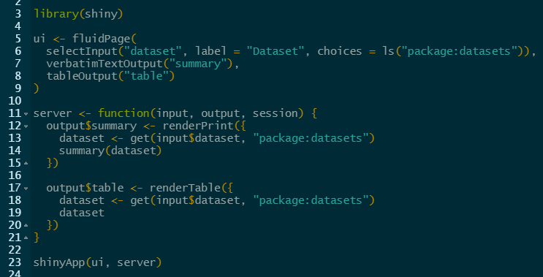
Outputs
If your UI specification creates an output with ID "plot", you’ll access it in the server function with output$plot.
Each output function on the front end is coupled with a render function in the back end.
Each render{Type} function is often paired with a {type}Output function.
Matching command
Commands in UI | Commands in server
dataTableOutput() | DT::renderDataTable(
imageOutput() | renderImage()
plotOutput() | renderPlot()
verbatimTextOutput() | renderPrint()
tableOutput() | renderTable()
textOutput() | renderText()
uiOutput() htmlOutput() | renderUI()
leafletOutput() | renderLeaflet()

Slide 32
Outputs widgets
Cheat sheet
Commands in UI | Commands in server
dataTableOutput(outputId) | DT::renderDataTable(expr, options, searchDelay, callback, escape, env, quoted, outputArgs)
imageOutput(outputId, width, height, click, dblclick, hover, brush, inline) | renderImage(expr, env, quoted, deleteFile, outputArgs)
plotOutput(outputId, width, height, click, dblclick, hover, brush, inline) | renderPlot(expr, width, height, res, …, alt, env, quoted, execOnResize, outputArgs)
verbatimTextOutput(outputId, placeholder) | renderPrint(expr, env, quoted, width, outputArgs)
tableOutput(outputId) | renderTable(expr, striped, hover, bordered, spacing, width, align, rownames, colnames, digits, na, …, env, quoted, outputArgs)
textOutput(outputId, container, inline) | renderText(expr, env, quoted, outputArgs, sep)
uiOutput(outputId, inline, container, …) htmlOutput(outputId, inline, container, …) | renderUI(expr, env, quoted, outputArgs)

Slide 33
Maps
#Server
pal <- colorFactor(palette = c("red", "green", "blue", "orange", "purple"),
levels = c("East Region", "North East Region", "West Region", "North Region", "Central Region"))
output$map <- renderLeaflet({
if (input$region=="All"){
display_map<-ec_geo2 %>%
leaflet() %>%
setView(lng = 103.8522, lat = 1.347510, zoom = 11) %>%
addTiles() %>%
addCircleMarkers(label = ~ pjname, color = ~ pal(`Planning Region`), radius = 3, fillOpacity = 0.5) %>%
addSearchOSM() %>%
addLegend(
"bottomleft",
pal = pal,
values = ~`Planning Region`,
opacity = 1, #color transparency
title = "Regions")}
if(input$region!="All") {
display_map<-ec_geo2 %>%
filter(`Planning Region` == input$region) %>%
leaflet() %>%
setView(lng = 103.8522, lat = 1.347510, zoom = 11) %>%
addTiles() %>%
addCircleMarkers(label = ~ pjname, color = ~ pal(input$region), radius = 3, fillOpacity = 0.5) %>%
#addSearchGoogle() %>%
addLegend(
"bottomleft",
pal = pal,
values = ~`Planning Region`,
opacity = 1, #color transparency
title = "Regions")
}
display_map
})
Input "region" from UI is pass to server, which produces output "map"
Output "map" is then passed to UI to be display in the mainPanel
#UI, dashboardBody, 1st tab
tabItem(tabName = 'Introduction',
fluidPage(
titlePanel("All Executive Condominiums in Singapore"),
sidebarLayout(
sidebarPanel(
selectInput("region", "Region:",
choices =
list('All', "North East Region", "North Region", "East Region", "West Region", "Central Region" )),
hr(),
helpText("Executive condominiums by Region."),
Position = "top"
),
mainPanel(
leafletOutput("map", height = 500)
)),

Slide 34
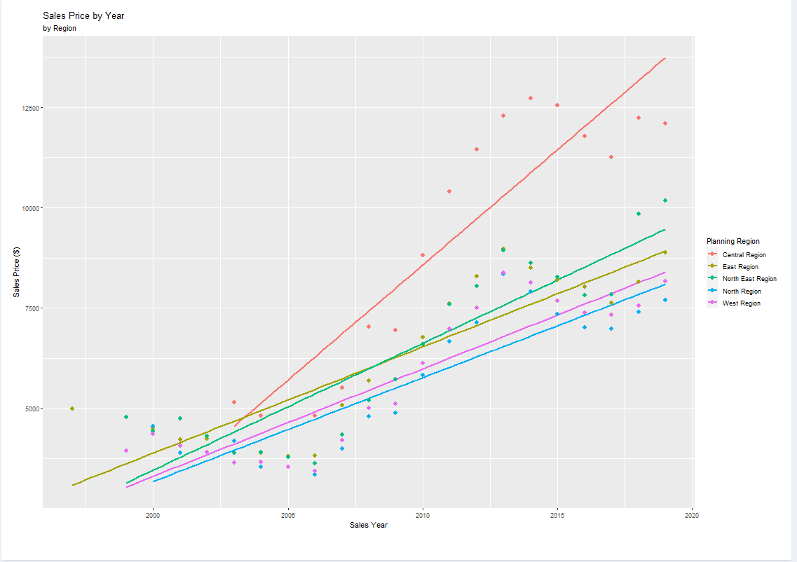
Charts
Static output, no input required for plot of sale price by year and planning region
# UI
fluidRow(
column(width = 12,
box(
width = 12,
height = 800,
solidHeader = TRUE,
collapsible = FALSE,
collapsed = FALSE,
plotOutput('regionanalysis', height = 750)
))
# Server
output$regionanalysis <- renderPlot({
data_rv <- ec_data %>%
group_by(`Planning Region`, Sale_Year) %>%
summarise(region_value = mean(`Unit Price ($ psm)`, na.rm = T))
data_rv$Sale_Year <- as.numeric(data_rv$Sale_Year)
p <- ggplot(data_rv, aes(y = region_value, x = Sale_Year)) +
geom_smooth(aes(col = data_rv$`Planning Region`), method = 'lm', se = FALSE) +
geom_point(aes(col = data_rv$`Planning Region`), size = 2.5) +
labs(title = 'Sales Price by Year', subtitle = paste('by', 'Region'),
col = 'Planning Region',x = 'Sales Year', y = 'Sales Price ($)',
fill = data_rv$`Planning Region`)
return(p)
})

Slide 35
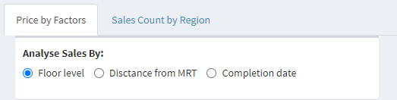
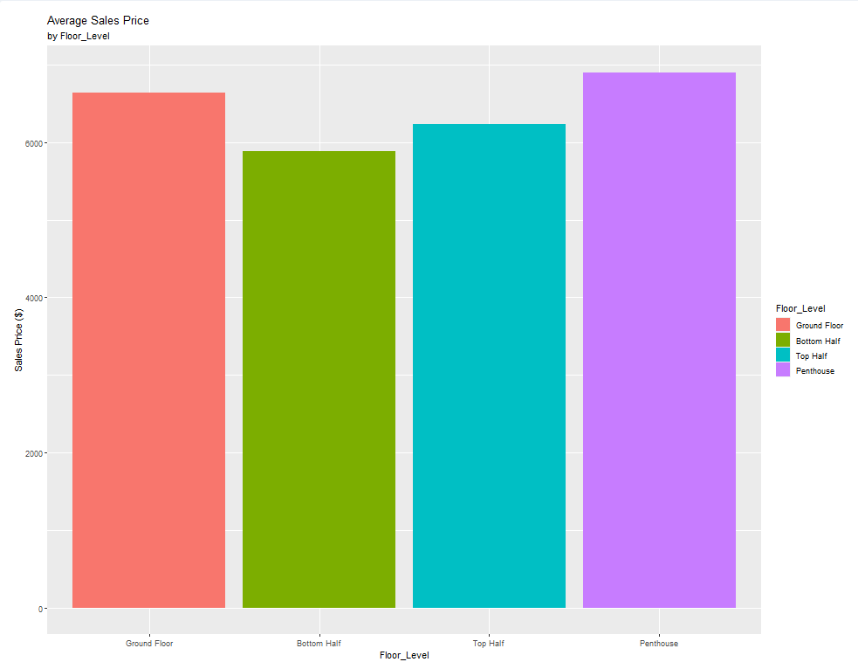
Descriptive Statistics
# UI, 1st tab
fluidPage(
titlePanel("Descriptive Statistics"),
fluidRow(
column(width = 12,
tabsetPanel(
tabPanel("Price by Factors",
box(
radioButtons('xcol',
label = tags$strong('Analyse Sales By:'),
choices = c('Floor level' = 'Floor_Level',
'Distance from MRT' = 'mrt_distance_grp',
'Completion date' = '`Completion Date`'),
inline = TRUE)
),
box(
width = 12,
height = 800,
solidHeader = TRUE,
collapsible = FALSE,
collapsed = FALSE,
plotOutput('descriptiveAnalysis', height = 750)
)),
Input xcol from radioButtons in UI is passed to renderPlot in Server to produce output descriptiveAnalysis.
Output from server is passed to plotOutput in UI.
# Server
output$descriptiveAnalysis <- renderPlot({
analysis <- ec_data %>%
group_by_(.dots = input$xcol) %>%
filter(`Completion Date` != 'Uncompleted', `Completion Date` != 'Unknown') %>%
summarise(basket_value = mean(`Unit Price ($ psm)`, na.rm = T))
p <- ggplot(analysis, aes_string(y = 'basket_value', x = input$xcol)) +
geom_bar(aes_string(fill = input$xcol), stat = 'identity') +
labs(title = 'Average Sales Price', subtitle = paste('by', input$xcol),
x = input$xcol, y = 'Sales Price ($)',
fill = input$xcol)
return(p)
})

Slide 36


Descriptive Statistics
# UI, 1st tab
tabPanel("Sales Count by Region",
box(
width = 12,
height = 800,
solidHeader = TRUE,
collapsible = FALSE,
collapsed = FALSE,
selectInput(
inputId = "Year",
label = "Select years:",
choices = 2000:2019),
plotOutput(outputId = "piechart",
height = "600")
))
Input Year from rselectInput in UI is passed to renderPlot in Server to produce output piechart.
Output from server is passed to plotOutput in UI.
# Server
output$piechart <- renderPlot({
data<-ec_data %>%
filter(Sale_Year == input$Year) %>%
group_by(`Planning Region`) %>%
summarise(count = n())
data<-data %>%
arrange(desc(`Planning Region`)) %>%
mutate(prop=round(count/sum(data$count)*100,2)) %>%
mutate(ypos=round(cumsum(prop)-0.5*prop, 2))
ggplot(data, aes(x="", y=prop, fill=`Planning Region`)) +
geom_bar(stat="identity", width=1, color="white") +
coord_polar("y", start=0)+
theme_void() +
geom_text(aes(y=ypos, label=paste0(prop,"%")), color="white")+
labs(title = 'The proportion of sale counts for differnet Planning Regions',
x = 'Planning Region') +
theme(plot.title = element_text(color = "Black", size = 14))
})

Slide 37


Plot output on the map

Slide 38

References:
ggplot cheat sheet: https://github.com/rstudio/cheatsheets/blob/master/data-visualization-2.1.pdf
Online version of ggplot2: Elegant Graphics for Data Analysis by Hadley Wickham, Danielle Navarro, and Thomas Lin Pederson: https://ggplot2-book.org/introduction.html
Winston Chang's R Graphics Cookbook: https://r-graphics.org/

Slide 39
All the best for your R Journey! Feel free to contact us if you have any question: Phuong: mphuynh.2022@mitb.smu.edu.sg Tasa: tasapornv.2021@mitb.smu.edu.sg
Last words…

